Slide 1
Adversarial Machine Learning based Partial-model Attack in IoT
Zhengping Luo (1), Shangqing Zhao (1), Zhuo Lu (1), Yalin E.Sagduyu (2), Jie Xu (3)
(1). University of South Florida, Tampa, FL, USA, {zhengpingluo@, shangqingzhao, zhuolu@}usf.edu
(2). Intelligent Automation Inc., Rockville, MD, USA, ysgduyu@i-a-i.com
(3). University of Miami. jiexu@miami.edu

Slide 2
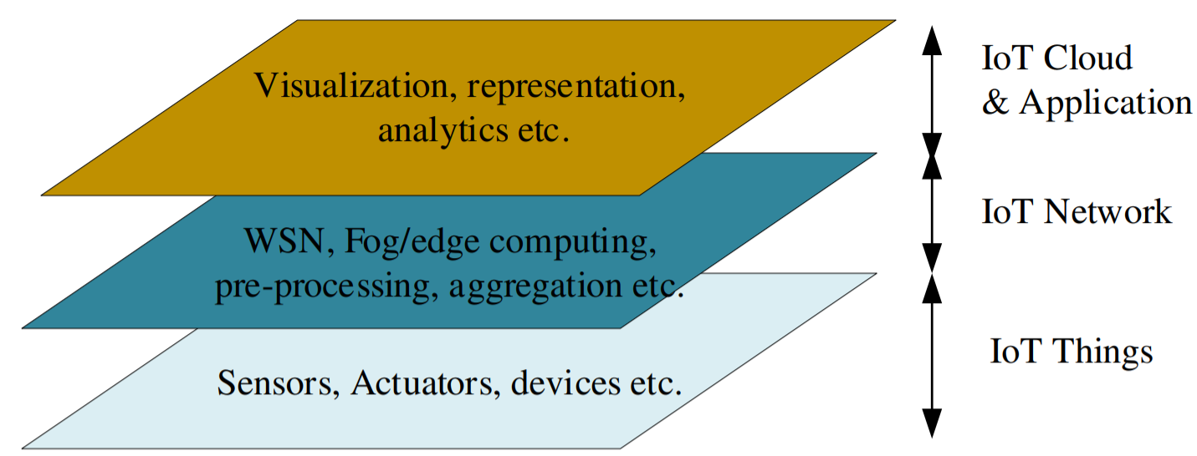
Generalized layers of IoT systems

Slide 3
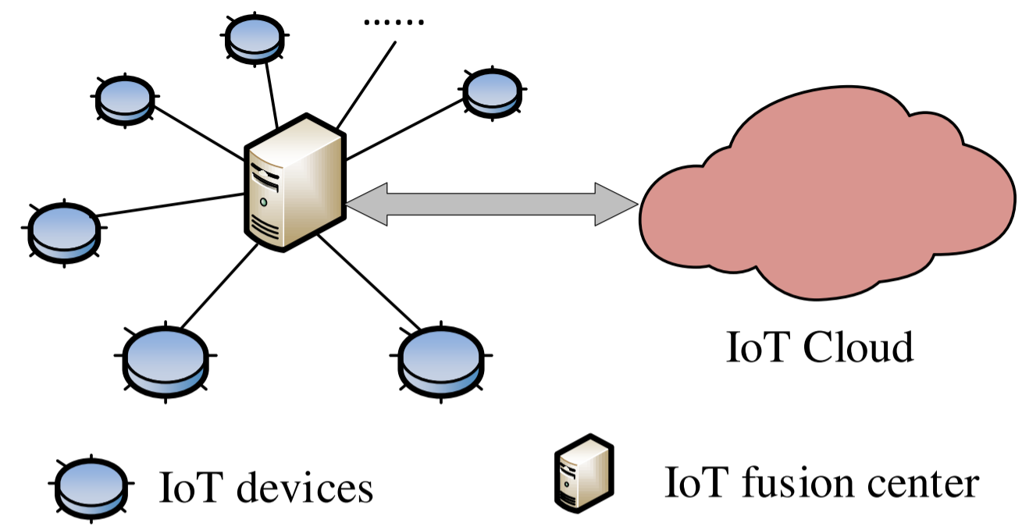
Simplified sensing and decision model

Slide 4
Vulnerabilities in data fusion/aggregation
Sensing devices are prone to failures.
Malicious attackers might control some devices.
Information are transferred over wireless channels.
Many fusion/aggregation decision are based on machine learning algorithms.

Slide 5
Machine Learning based Partial-model Attack

Slide 6
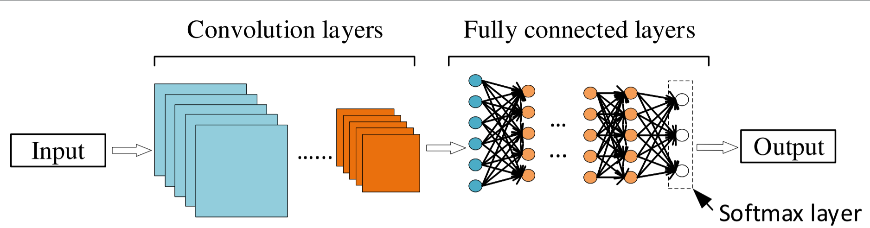
Convolutional Neural Networks

Slide 7
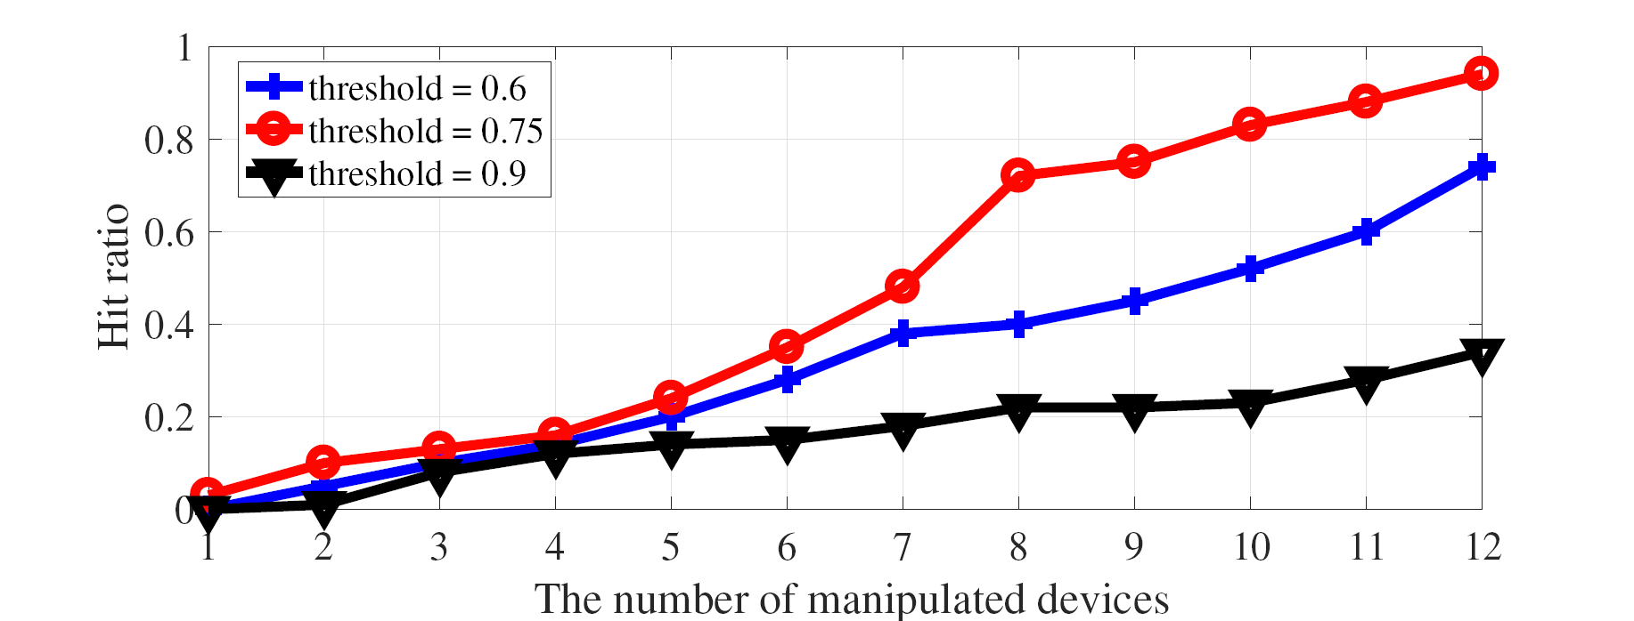
Performance Evaluation
The relationship of the number of controlled sensing devices with the hit ratio.

Slide 8
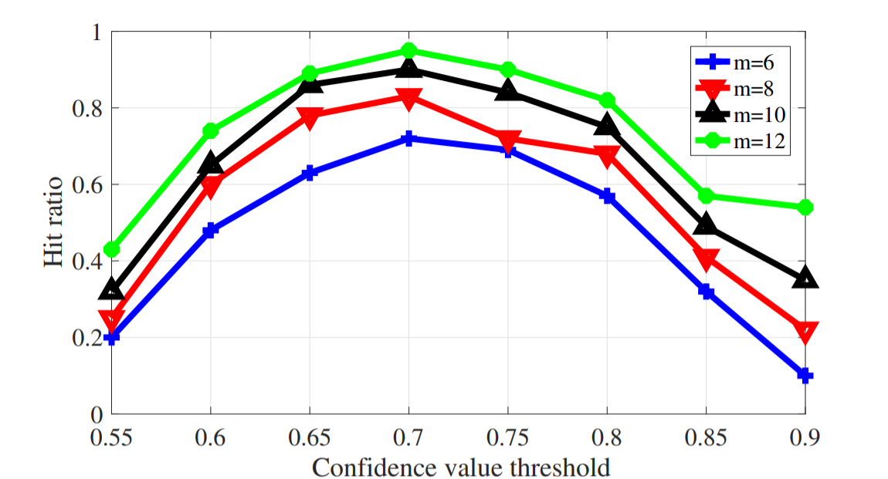
Performance Evaluation
Hit ratios under different confidence thresholds and different number of manipulated devices.

Slide 9
Potential Countermeasures
Deploying robust anomaly detection mechanism
Improving privacy protection in each layer of the IoT infrastructure

Slide 10
Thank you all for your time

