Slide 1
Comb Decoding towards Collision-Free WiFi
Shangqing Zhao , Zhe Qu, Zhengping Luo, Zhuo Lu, Yao Liu
University of South Florida
Notes:
Good morning everyone. My name is Shangqing Zhao from the University of South Florida. I am very pleasure to present our work. The tile is comb decoding towards collision free wifi. The coauthors are Zhe Qu, Zhengping Luo, Zhuo Lu, and Yao Liu.

Slide 2

How Wireless Communication Changed the World
Notes:
We know wifi has already become most popular way to connect to the internet, and it has covered everywhere of our daily life.

Slide 3
Collision
Broadcast nature of wireless communication
  Devices need to access to the wireless channel one by one
Notes:
But because of the broadcast nature of wireless channel, collision is still a problem, which is not resolvable, for current wifi. So two devices has to access the wireless channel one by one.

Slide 4

Collision
Broadcast nature of wireless communication
  Collision happens if they communicate together
Collision
Extremely affect the throughput of the network!!
Notes:
If they transmit together, collision will happen, this will extremely affect the network throughput.

Slide 5


RTS/CTS based Channel Sensing
RTS/CTS based CSMA/CA
CSMA
Protected by RTS (NAV)
back-off
Transmitter
RTS
Data
SIFS
SIFS
SIFS
Receiver
CTS
ACK
Notes:
So in order to avoid collision, RTS/CTS based channel sensing has been widely used in current wifi.
Basically,
if there is a data packet to be sent,
after a random backoff, it will first transmit a rts packet, then the receiver respond a cts, now transmitter is allowed to send the data packet, and finally, the receiver feedback with an ack.
So this time period is actually protected by RTS signal, which is called NAV, and it can guarantee there is no collision.
But how about this period?

Slide 6
RTS Collision
RTS packets are possible to collide when multiple devices select the same back-off time slot.
Contention Window
DIFS
RTS
1
2
3
4
5
Collision
They choose the same backoff slot (e.g. 5)
DIFS
RTS
1
2
3
4
5
Can we resolve the collision?
Notes:
Actually if two devices choose the same backoff, the following two RTS will collide.
Can to figure out this problem?

Slide 7
Collision Resolution
Collision
Consider the ideal channel
Collided RTS
RTS from device 1
RTS from device 2
Notes:
First let take a look at the collision equation.
X1 and x2 are rts from two devices, so at the receiver, y is the collided signal. H1 and h2 are channel coefficients.
Lets consider a simple scenario, there is no fading,

Slide 8

Collision Resolution
Collision
Given , and are not solvable.
Collided RTS
RTS from device 1
RTS from device 2
If x₁ and x₂ are absolutely random
What if x₁ or x₂ are not absolutely random?
Notes:
Then we have this equation. We know, if x1 and x2 are random, and only given y, it is impossible to solve x1 and x2, this explain why collision is not resolvable.
But, lets see this assumption, what if x1 and x2 are not absolutely random?

Slide 9

Collision Resolution
Collision
Constraint:
Then
Notes:
Suppose we have 2 constraints …
Now if y equals to 23, then we know x1 must be 3 and x2 must be 20.
Amazing ha, we solve this equation. How to do this?

Slide 10

Collision Resolution
Collision
Matrix Form
where,
and
Sparse Vector
Compressive Sensing
Resolving $x_{1}$ and $x_{2}$ becomes resolving $g$
Notes:
Now we convert it into a matrix form, we get this equation, and resolve x1 and x2 becomes solve this g. In this equation, g is sparse, we can use compressive sensing to solve it.

Slide 11
Collision Resolution
Collision
Matrix Form
where,
and
Sparse Vector
Notes:
Like this example, only two entries are 1 to locate 3 and 20, so it is sparse.

Slide 12
Collision Resolution
Collision
Constraint:
Constrains on $x_{1}$ and $x_{2}$ are necessary to resolve $x_{1}$ and $x_{2}$.
Notes:
Now we know the constraints or the 2 sets are important to resolve this equation, which is collision.

Slide 13

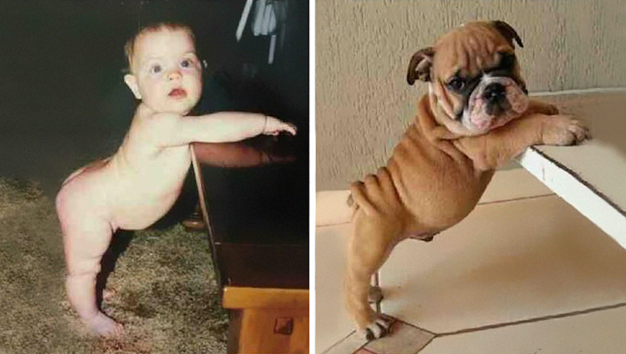
Collision Resolution
Collision
RTS from device 1
RTS from device 2
Do we have the similar constrains on RTS signals?
Notes:
Do we have the similar constraints if x1 and x2 are rts. The answer is yes.

Slide 14

RTS
RTS structure
160 bits
RTS
Frame Control
Duration
Receiver Address
Transmitter Address
FCS
Length: 16 bits 16 bits 48 bits 48 bits 32 bits
Uniform Distribution
Size: 2¹⁶⁰
Constraint
Notes:
Lets look at the rts frame structure,
the length in total is 160 bits.
So if all bits are random, then the size of this set, which is the constraint, should be 2^160.

Slide 15
RTS
RTS structure
160 bits
RTS
Frame Control
Duration
Receiver Address
Transmitter Address
FCS
Length: 16 bits 16 bits 48 bits 48 bits 32 bits
2¹⁶⁰
2¹⁴⁴
  This field is fixed and specified by 802.11 standard.
Constrain
Notes:
But if we inspect each field, we find these bits are not random actually.

Slide 16
RTS
RTS structure
160 bits
RTS
Frame Control
Duration
Receiver Address
Transmitter Address
FCS
Length: 16 bits 16 bits 48 bits 48 bits 32 bits
2¹⁴⁴
2⁹⁶
  Its own address
Constraint
Notes:
The receiver address is also not random, so the size decrease to 2^96

Slide 17
RTS
RTS structure
160 bits
RTS
Frame Control
Duration
Receiver Address
Transmitter Address
FCS
Length: 16 bits 16 bits 48 bits 48 bits 32 bits
2⁹⁶
2⁵⁴
  Address of its transmitters.
  Each receiver can only support limited number of transmitters at the same time.
  Assume it has 64 = 2⁶ transmitters
Constraint
Notes:
For the transmitter address, because an ap can only support limited number of transmitter, we assume there are 2^6 tranmsmitters, now the size become ..

Slide 18
RTS
RTS structure
160 bits
RTS
Frame Control
Duration
Receiver Address
Transmitter Address
FCS
Length: 16 bits 16 bits 48 bits 48 bits 32 bits
2⁵⁴
2²²
  Error correction code (CRC)
Constraint
Notes:
For the last one, it is also not random, so we have 2^22.

Slide 19

RTS
RTS structure
160 bits
RTS
Frame Control
Duration
Receiver Address
Transmitter Address
FCS
Length: 16 bits 16 bits 48 bits 48 bits 32 bits
2²²
  Specify the NAV in microsecond
  The NAV value should be random
Constraint
Notes:
The duration specifies the nav values, which is the length of the following data packet, so it suppose to be random, because the length of the following data is unknown. But is it really random?

Slide 20





WiFi Packet Trace Analysis
802.11n/ac
1.3 TB in total
2.33 billion packets
Cover 191 days
6 realistic environments:
  public library
  academic conferences
  residential communities
  hotels
  airports
  research lab
Notes:
In order verify if the nav is random. We collect our own data trace

Slide 21
WiFi Packet Trace Analysis
  NAV distribution versus different locations
Notes:
Here is the nav distribution at different location

Slide 22

WiFi Packet Trace Analysis
Belkin
  NAV distribution versus different Brand
Notes:
And this is the distribution for different brands, like this we can see the values only focus on several points.

Slide 23

RTS
RTS structure
160 bits
RTS
Frame Control
Duration
Receiver Address
Transmitter Address
FCS
Length: 16 bits 16 bits 48 bits 48 bits 32 bits
2²²
2¹²
2¹²
  Specify the NVA in microsecond
  The NAV value should be random
  Assume it has 64 = 2⁶ NVA values
Constraint
Notes:
So this statement is wrong, assume it has 2^6 values, the size shrink to 2^12, which is feasible.

Slide 24
Collision Resolution
Collision
Constraint: ,
,
A set containing all RTS from device 1
Notes:
We call the set of x1 as omega 1, so the size is 2^12, same for the x2.

Slide 25
Collision Resolution
Collision
Matrix Form
where,
and
size: 2*2¹²
solvable
Notes:
again, we have this matrix form. because there are 2 devices, the size of M is 2 times 2 ^ 12. It is not too large, so solving g is feasible, which means collision can be resolved.

Slide 26

Collision Resolution
Collision
Comb Decoding (CombDec)
: Comb Matrix
: tooth vector
Given and , solve
Comb
Notes:
They key idea is to leverage the distribution of nav,
which looks like a comb
so we call our method comb decoding.

Slide 27

Collision Resolution
Collision
How to build M at the receiver?
Notes:
M is important for our method, so how to build it at the receiver.

Slide 28
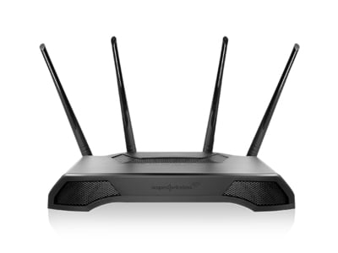
CombDec
Restore RTS when no collision happens
Tooth Table
Recoding
i0i0
Reply CTS
Decoding
CRC
1001
1001
Traditional Receiver
1001
Data decoding
1001
Notes:
Basically, if a packet comes, it will first go through the traditional decoder, and if there is errors, then we recode it into the complex form and store it in a table, and reply the CTS.

Slide 29
CombDec
Store RTS when no collision happens
CombDec
Tooth Table
i0i0
00ii
Collided RTS
Reply CTS
i i i i
i i I 0
1111
1100
CRC
Decoding
1101
Traditional Receiver
1001
Data decoding
1001
Notes:
Again, when a new packet comes, if the error checking is wrong, it means collision happens, then the comb decoding will be triggered. It will generate the tooth matrix M from the table. And retrive the collided signal y. and based on this equation, resovle g. so the collision is from these two rts vectors. And then decode them again, if no error happens, we know the collision is resolved. And we can reply CTS.

Slide 30
CombDec Architecture
CombDec is involved only when collision happens
Notes:
Here is the architecture of comb decoding, it is triggerd on when collision happens. And we use .. To further manage the comb matrix m.

Slide 31
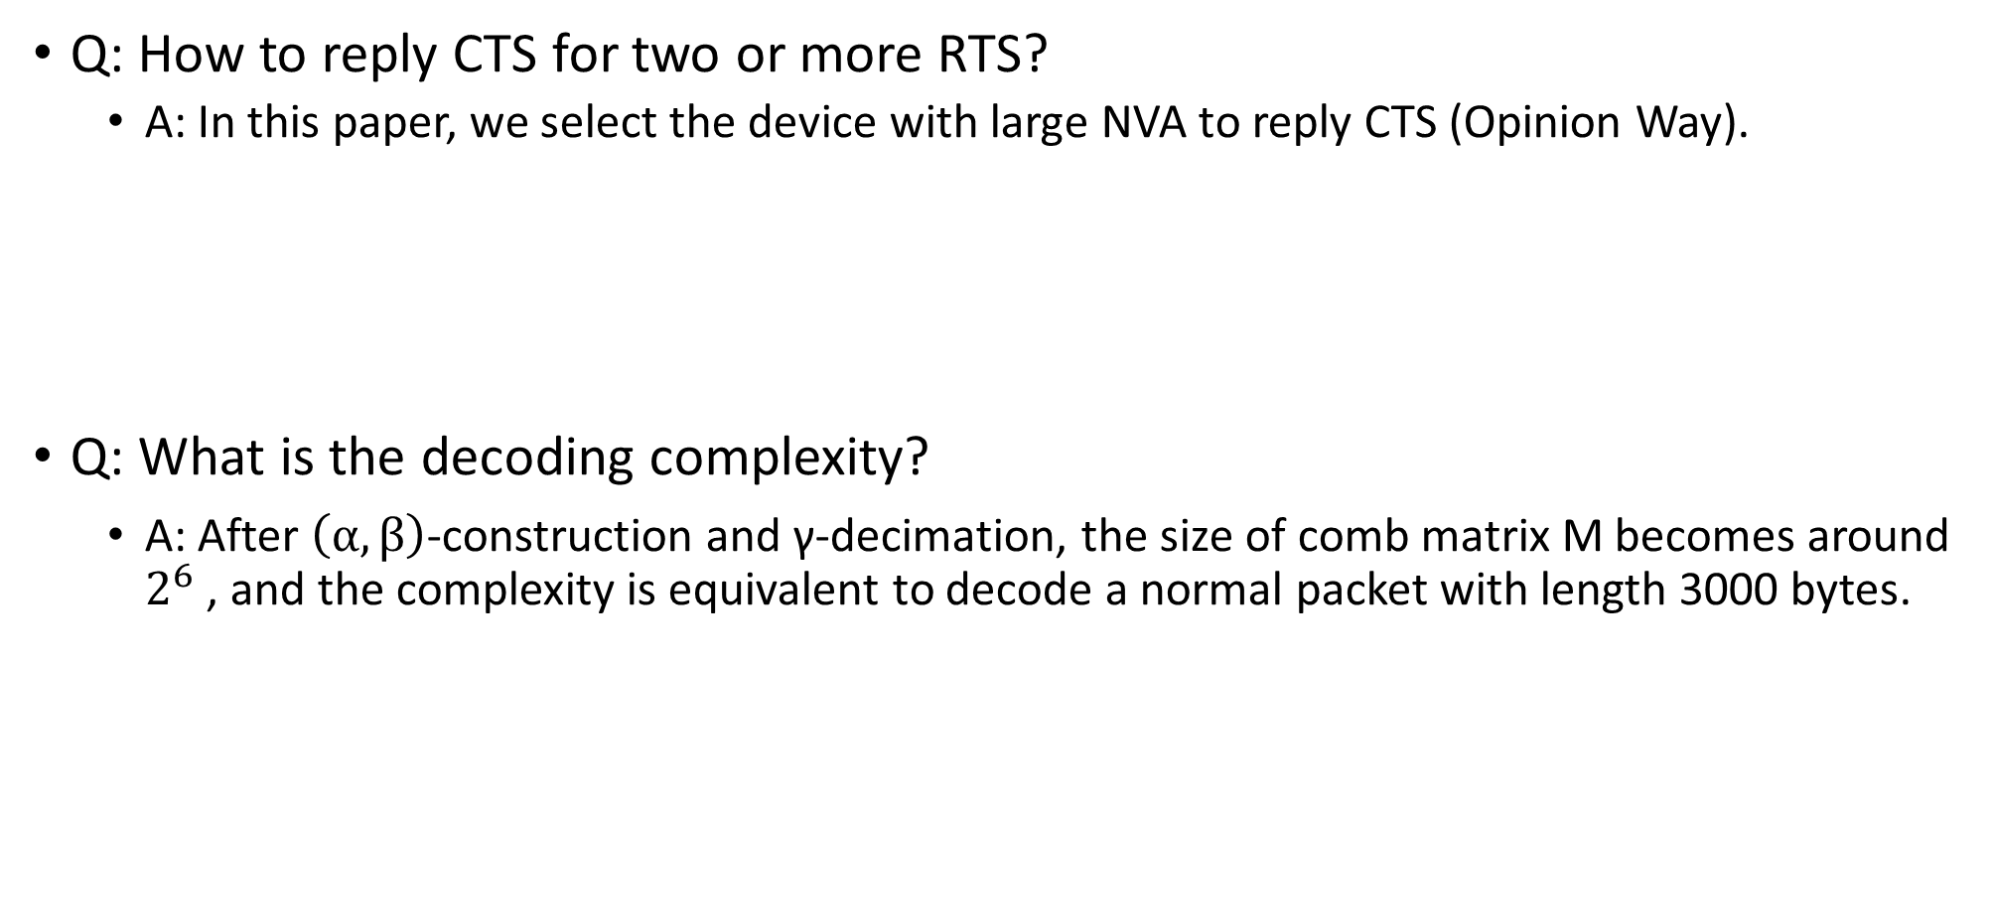
Addressing Issues
Q: How to reply CTS for two or more RTS?
  A: In this paper, we select the device with large NVA to reply CTS (Opinion Way).
  Q: What is the decoding complexity?
    A: After $\left(α,β\right)$-construction and γ-decimation, the size of comb matrix M becomes around $2^{6}$ , and the complexity is equivalent to decode a normal packet with length 3000 bytes.
Notes:
Here are some practical issus. This first one is how to reply CTS, in our paper, we reply the device with large nav.

Slide 32
Implementations
Experimental setup
  20 USRP X310s with UBX daughterboards
  802.11ac PHY-MAC architecture with 20-MHz settings
  Control Packets: RTS, CTS, ACK.
  Data packets are generated from our data trace
  Network Topology
Notes:
We implement it in a campus environment.

Slide 33
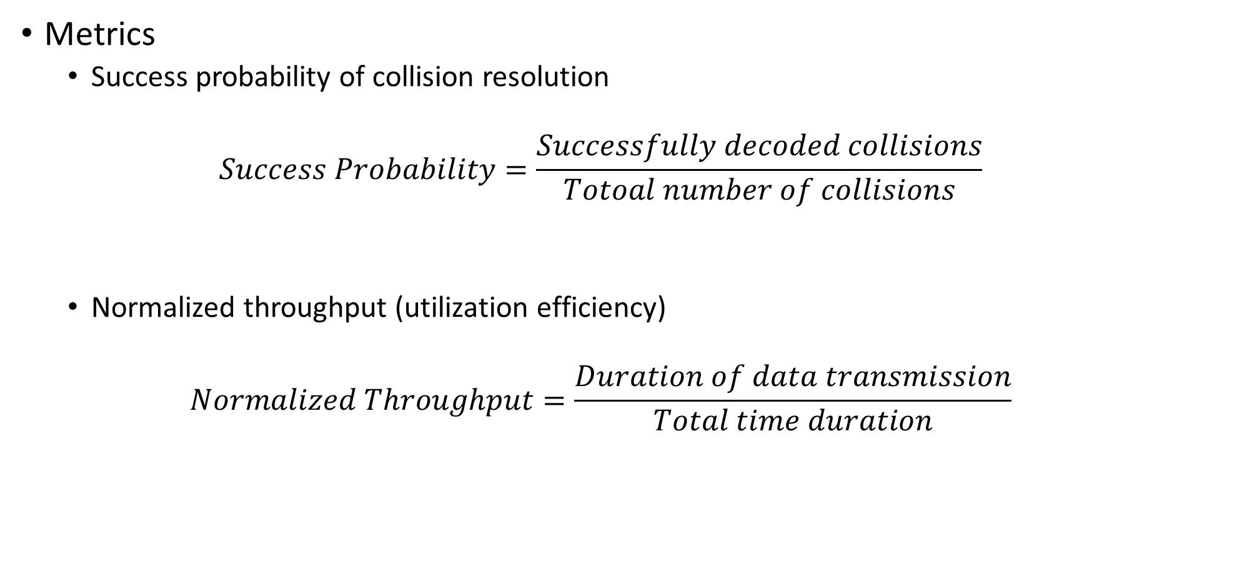
Implementations
Metrics
  Success probability of collision resolution
  $$Success Probability=\frac{Successfully decoded collisions}{Totoal number of collisions}$$
  Normalized throughput (utilization efficiency)
  $$Normalized Throughput=\frac{Duration of data transmission}{Total time duration}$$
Notes:
And us success probability of collision resolution and normalized throughput as matrics

Slide 34
Single Link Evaluation
RTS-RTS collision
  AP is placed at location 0, and all RTS stations are at location 1.
  All Stations send RTS at the same time.
AP
STAs
Notes:
We first evaluate the single link performance. And see as the time goes by, the success probability of collision resolving increase sharply, because at the very beginning, we need to build the comb matrix.

Slide 35
Single Link Evaluation
RTS-Data collision
  Station sending RTS is placed at Location 1;
  Station sending data is placed at location 1 – 8;
  AP is at location 0.
AP
RTS STA
Door
Notes:
Our method can also decode rts and data collision., we can see if the power of data packet is weak, we can resolve around 50% collisions.

Slide 36
Network Evaluation
Single Network
  AP is place at Location 0.
  CombDec is universally better than traditional decoder.
AP
Notes:
Here is a single network evaluation. We can see combdec is universally better than traditional receiver.

Slide 37
Network Evaluation
Single Network
  AP is place at Location 0.
  Traditional RTS threshold: 2300 bytes
  CombDec can be used to build a network towards collision-free
Notes:
In current wifi, rts is used only when the data packet is longer than 2000 bytes, because rts is also possible to collide. Out mthod can resovle rts collision, so we can evaluate the performance if we change the rts threshold. we can see, when we decese the rts threshold, the throughput increase.

Slide 38
Network Evaluation
Two Networks
  Aps are placed at location 8 and 15.
AP
Notes:
We have the common information now, so the next question is how to harness such common information to improve the signal processing?

Slide 39
Summaries
We proposed a new method (CombDec) to decode RTS collision.
With CombDec, we can turn down the RTS threshold to 0, yielding a network towards collision-free.

Slide 40
Thank you

